Slide 1

Gold Price Prediction
Analysis and Forecasting Using Time Series Machine Learning Models
Presented by: Jainisha Choksi
Intern Id: MST03-0039
Guided by:Ms. Urooj Khan
Company: Meta Scifor Technologies

Slide 2
Table of Contents
Introduction
Data COllection and Preprocessing
Exploratory Data Analysis
Understanding Gold Price and Its Forecasting using Time Series
Forecasting Methods for Gold Price
ARIMA and SARIMA Models
Conclusion
References

Slide 3
Introduction
Predicting the future price of gold is a challenging task, given its various determinants and the volatile market environment. However, with the help of machine learning and time series models we can predict the gold price.

Slide 4
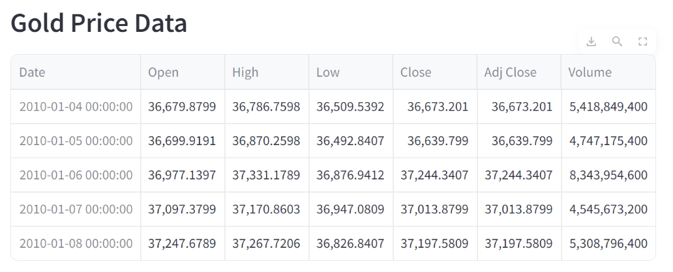
Data Collection and Preprocessing
Web Scrapping: Utilizing web scrapping techniques to gather historical gold price data from investing.com website. Data from 01st Jan 2010 to 08th April 2024
Data:

Slide 5
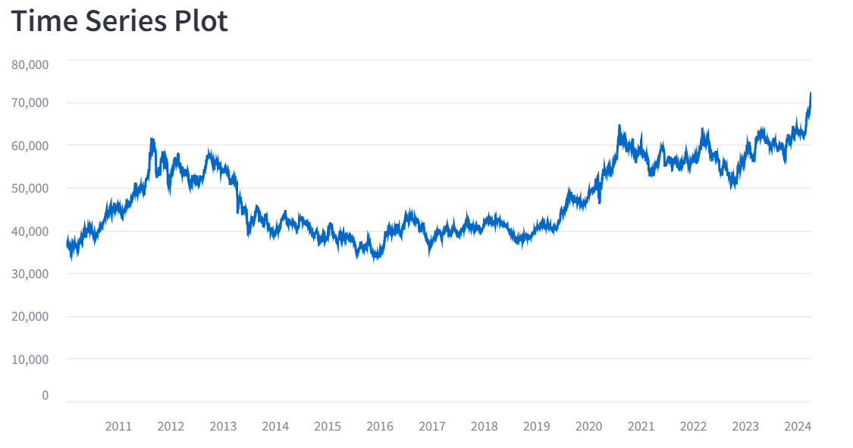
Exploratory Data Analysis

Slide 6
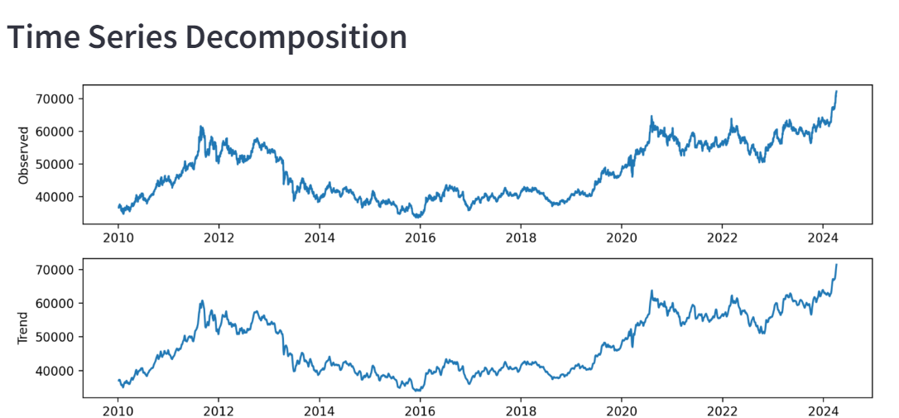
Exploratory Data Analysis

Slide 7
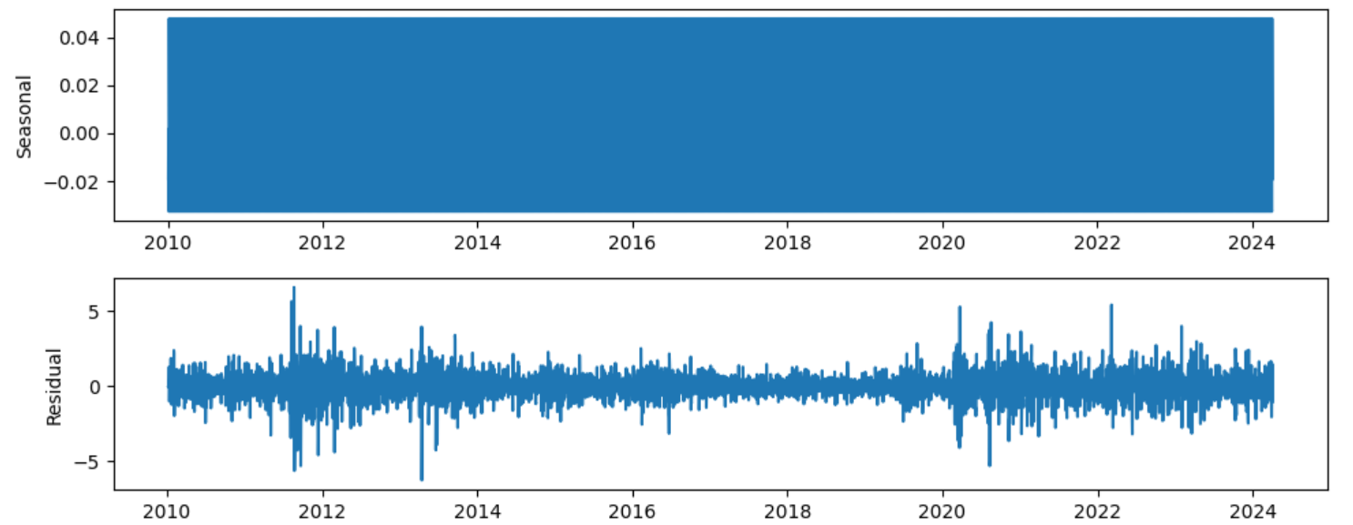
Exploratory Data Analysis

Slide 8
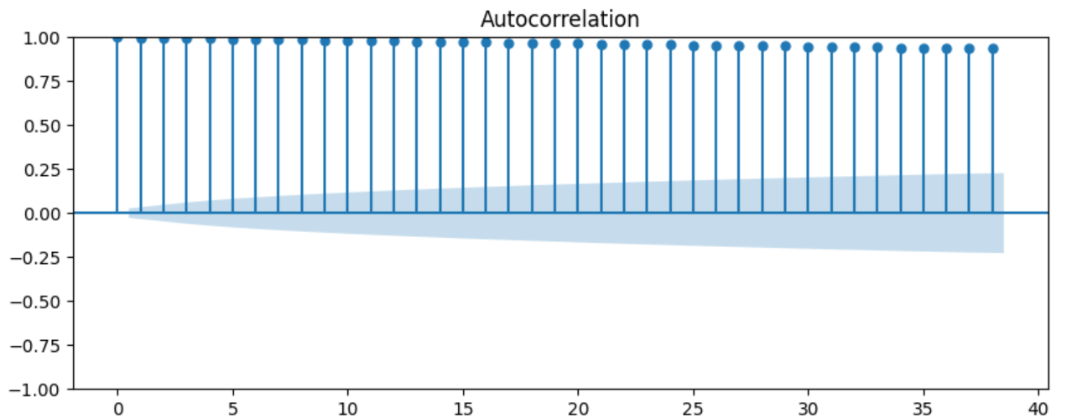
Exploratory Data Analysis

Slide 9
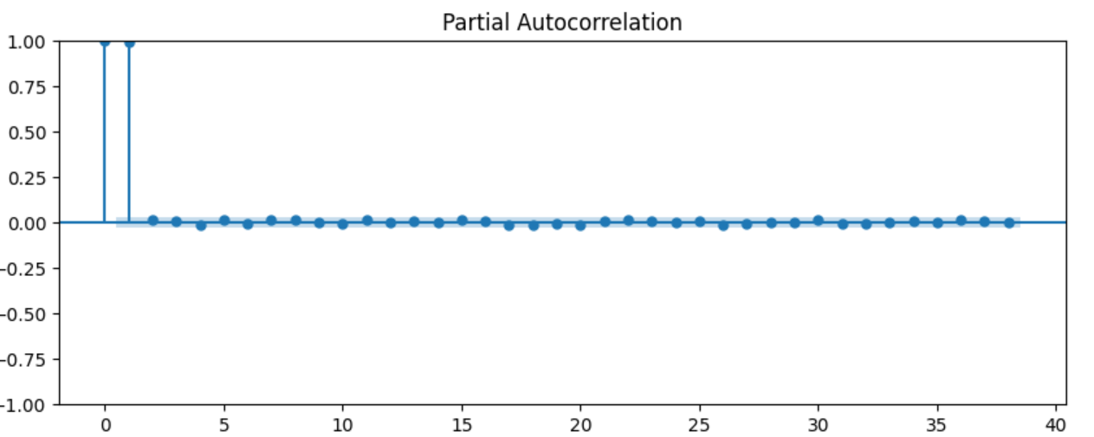
Exploratory Data Analysis

Slide 10
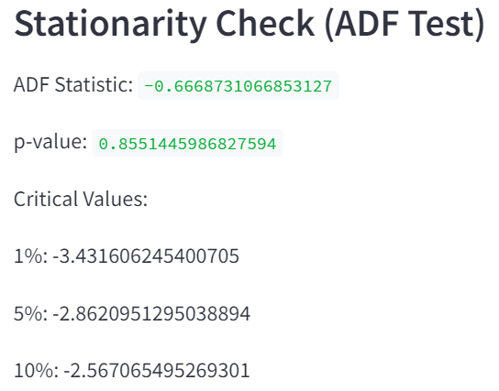
Exploratory Data Analysis

Slide 11
Forecasting Methods for Gold Price
Regression Models
Linear Regression
Decision Tree Regression
Random Forest Regression
Time Series Machine Learning Models:
ARIMA
SARIMA

Slide 12
Time Series Models
ARIMA (AutoRegressive Integrated Moving Average)
AutoRegressive: This components models the relationship between an observation and a number of lagged observations.(Current values and Previous values over a specific time period).
Integrated: This components deals with the differencing of raw observations to make the time series stationary. Stationary is crucial for ARIMA model.
Moving Average: This component models the relationship between an observation and a residual error from a moving average model applied to lagged observations. It captures the effects of past forecast errors.
Hyperparameters of ARIMA(p,d,q):
p- order of AR
d- degree of differencing
q- order of MA

Slide 13
Time Series Models
SARIMA (Seasonal AutoRegressive Integrated Moving Average)
SARIMA extends the ARIMA model to handle seasonal patterns in time series data.
Hyperparameters:
p- seasonal order of autoregressive
d- seasonal order of differencing
q- seasonal order of moving average
s- length of the seasonal cycle
SARIMA is useful when dealing with data that exhibits periodic patterns or seasonality or seasonal fluctuations.

Slide 14
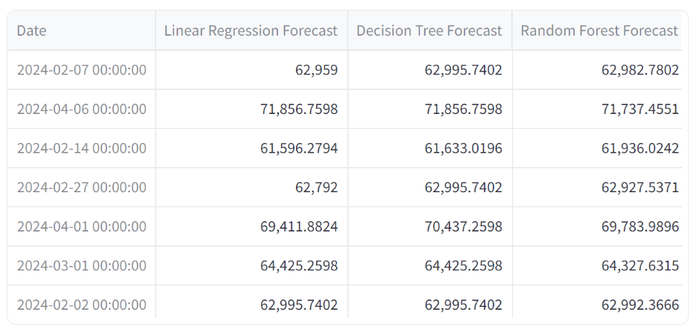
Result
Regression Models:

Slide 15
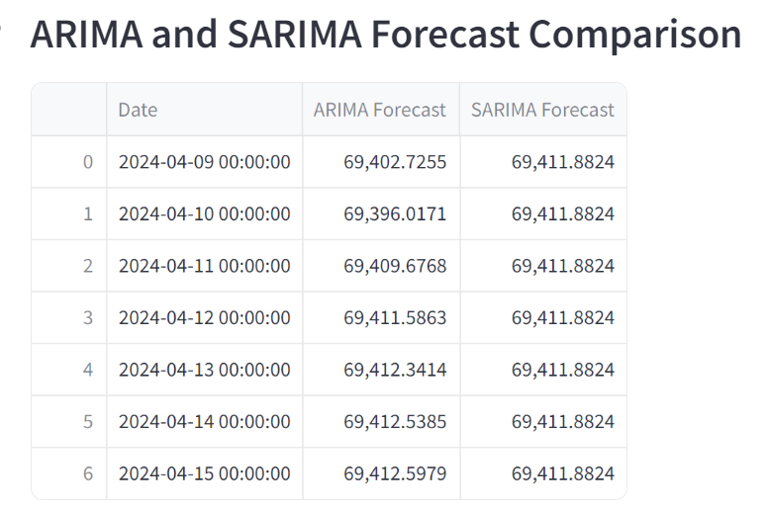
Result
Time Series Models:

Slide 16
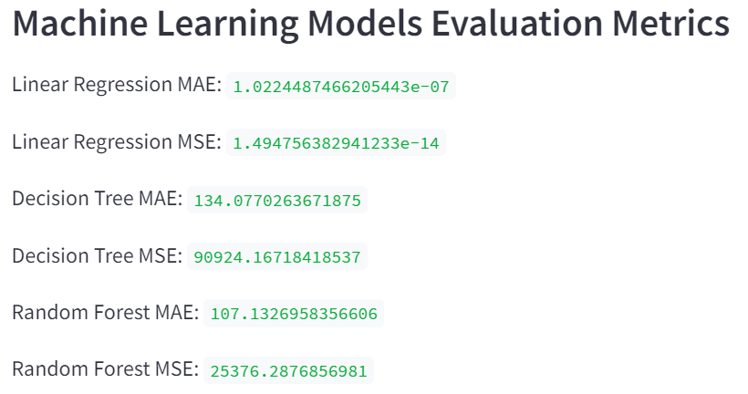
Result

Slide 17
Conclusion
Time series models outperforms regression models for gold price prediction due to their capability to capture temporal dependencies and seasonality.
Time Series models are ideal for sequential data, making them suitable for forecasting gold price which exhibits temporal patterns.
Regression models may be preferable for understanding broader relationships between gold prices and external factors.

Slide 18
References
Xiaohui Yang, ”The Prediction of Gold Price Using ARIMA Model,” 2nd International Conference on Social Science, Public Health and Education 2019
geeksforgeeks/gold-price-prediction-using-machine-learning
V. G. S and H. V. S, "Gold Price Prediction and Modelling using Deep Learning Techniques," 2020 IEEE Recent Advances in Intelligent Computational Systems (RAICS), Thiruvananthapuram, India, 2020, pp. 28-31, doi: 10.1109/RAICS51191.2020.9332471. keywords: {Gold;Recurrent neural networks;Time series analysis;Predictive models;Market research;Data models;Investment;LSTM;Exponential;CNN;RNN;Prediction;Estimation},
Investing.com Gold Historical Data

